Slide 2

Integrating Blazor with Existing .NET Web Apps
Ed Charbeneau
Principal Developer Advocate at Progress Software

Slide 3
ASP.NET Core UI, the choice is yours
ASP.NET Core
Razor Views (MVC)
Razor Pages
Razor Components
Headless (Web API + JavaScript)

Slide 4
ASP.NET Core UI, the choice is yours
Razor Views (MVC)
Razor Pages
Razor Components
Headless (Web API + JavaScript)

Slide 5

ASP.NET Core UI, the choice is yours
Razor Views (MVC)
Razor Pages
Razor Components
Headless (Web API + JavaScript)

Slide 6
ASP.NET Core UI, the choice is yours
Razor Views (MVC)
Razor Pages
Razor Components
Headless (Web API + JavaScript)

Slide 7
ASP.NET Core UI, the choice is yours
Razor Views (MVC)
Razor Pages
Razor Components
Headless (Web API + JavaScript)

Slide 8

ASP.NET Core is Modular
01: var builder = WebApplication.CreateBuilder(args);
02: // Add Web API controllers
03: builder.Services.AddControllers();
04: // Add Razor Views
05: builder.Services.AddMvc();
06: var app = builder.Build();
07: // Configure Routing
08: app.MapControllers();

Slide 9


ASP.NET Core is Modular
01: var builder = WebApplication.CreateBuilder(args);
02: // Add Web API controllers
03: builder.Services.AddControllers();
04: // Add Razor Views
05: builder.Services.AddMvc();
06: var app = builder.Build();
07: // Configure Routing
08: app.MapControllers();
HTTP:

Slide 10

ASP.NET Core is Modular
01: var builder = WebApplication.CreateBuilder(args);
02: // Add Web API controllers
03: builder.Services.AddControllers();
04: // Add Razor Views
05: builder.Services.AddMvc();
06: var app = builder.Build();
07: // Configure Routing
08: app.MapControllers();
cshtml
HTTP:

Slide 11
ASP.NET Core is Modular
01: var builder = WebApplication.CreateBuilder(args);
02: // Add Web API controllers
03: builder.Services.AddControllers();
04: // Add Razor Views
05: builder.Services.AddMvc();
06: var app = builder.Build();
07: // Configure Routing
08: app.MapControllers();
MVC App

Slide 12


ASP.NET Core is Modular
01: var builder = WebApplication.CreateBuilder(args);
02: // Add Web API controllers
03: builder.Services.AddControllers();
04: // Add Razor Views
05: builder.Services.AddMvc();
06: var app = builder.Build();
07: // Configure Routing
08: app.MapControllers();
https://myapp.net/my-resource-location

Slide 13

ASP.NET Core UI, the choice is yours
Razor Views (MVC)
Razor Pages
cshtml
cshtml
MapControllers
MapBlazorHub
Razor Components
Headless (Web API + JavaScript)
MapRazorComponents
razor
html

Slide 14

Modernization with Razor Components
Full-stack .NET (C#)
Little to no JavaScript
Enhanced Productivity
Component architecture
Data Binding
Intuitive Templating
Rendering Options
Static Server (HTML)
Server Interactive (SignalR)
Client Interactive (WASM)

Slide 15
Component TagHelper
Syntax
Usage
<component type="typeof(ModelDetails)"
param-Model="Model"
render-mode="ServerPrerendered" />
Render a Razor Component from a Razor View
Razor Pages
Razor Views (MVC)
Equivalent to…
<ModelDetails Mode="Model"/>

Slide 16

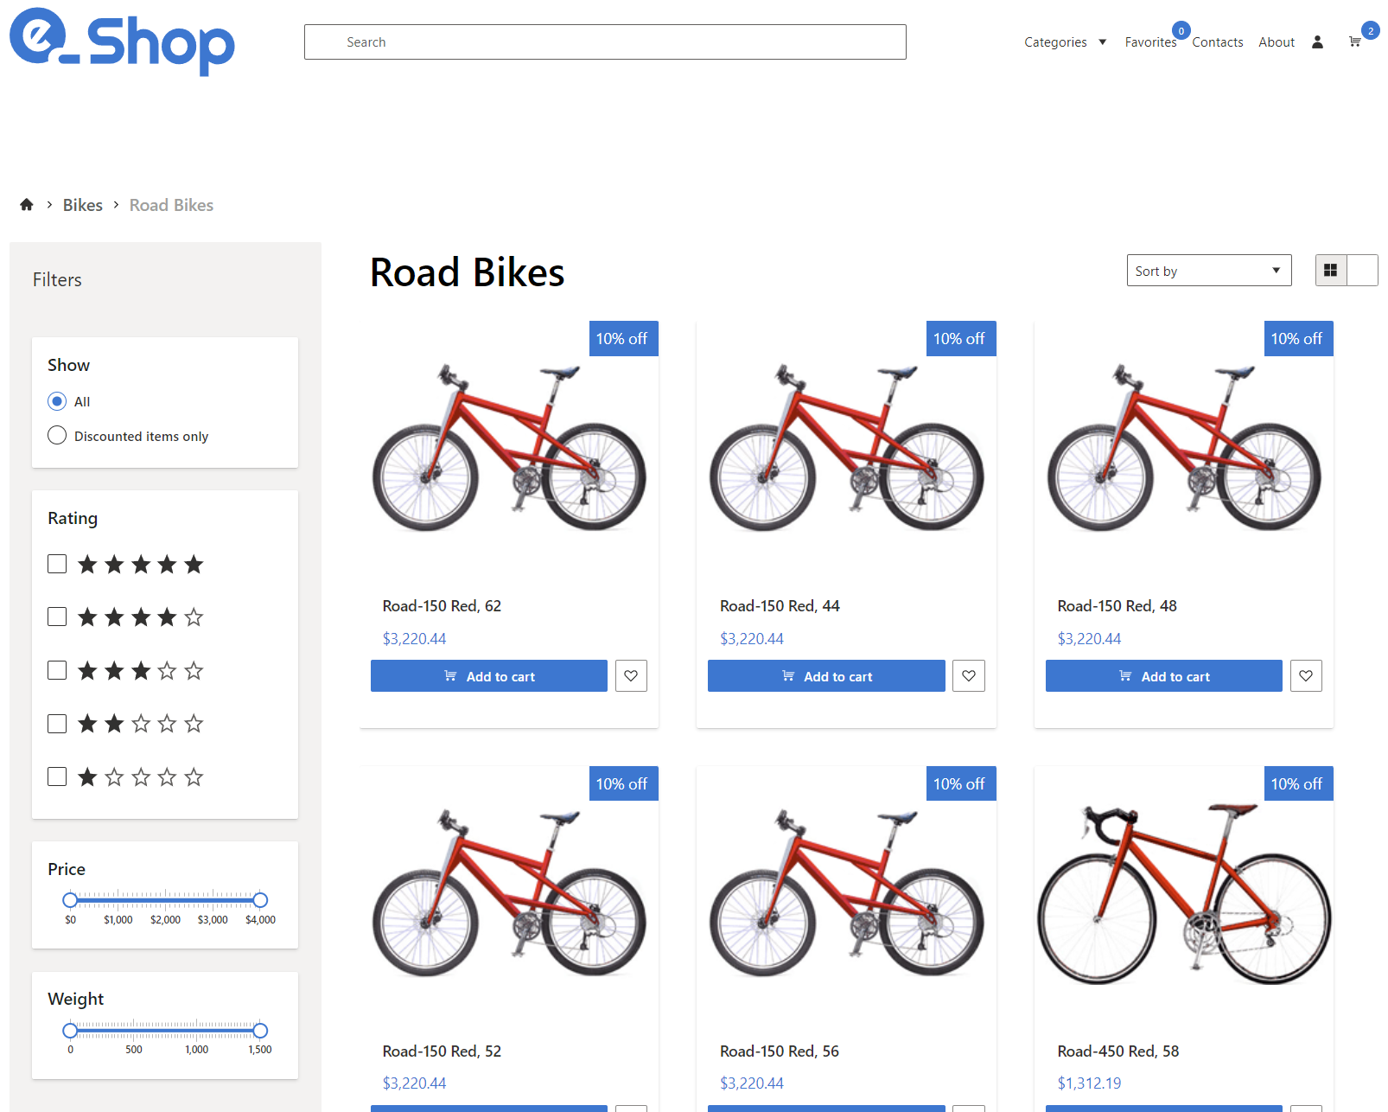
Demo
Integrating Blazor with an existing ASP.NET Core MVC App

Slide 17
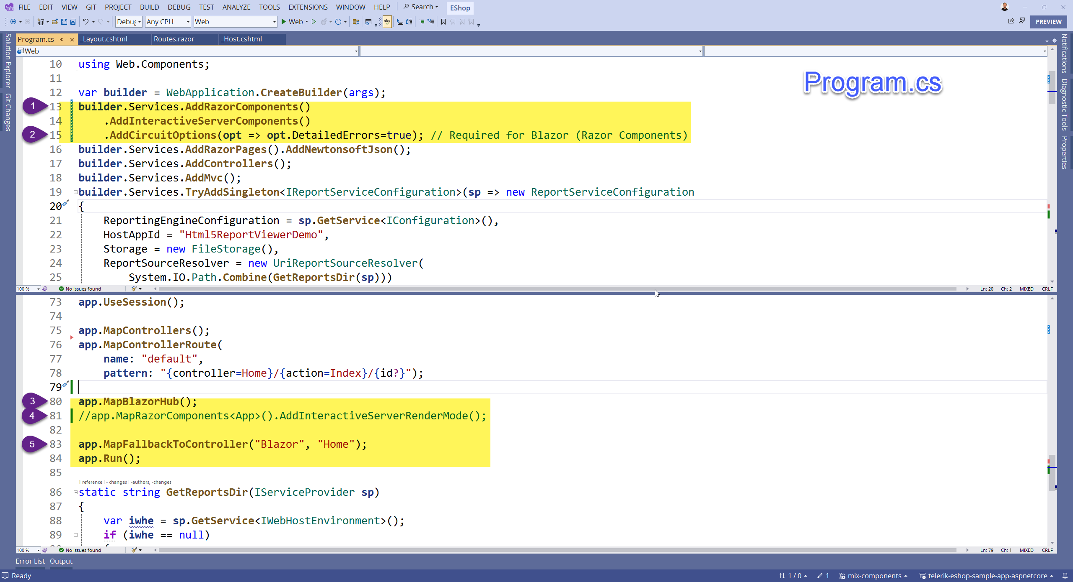

Slide 18
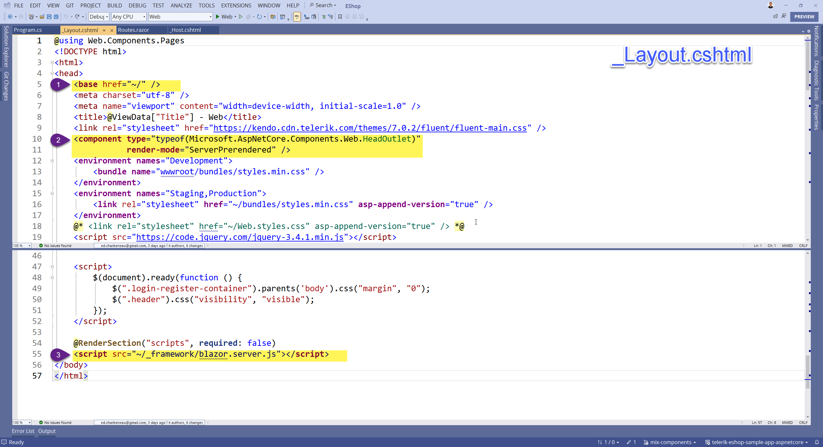

Slide 19
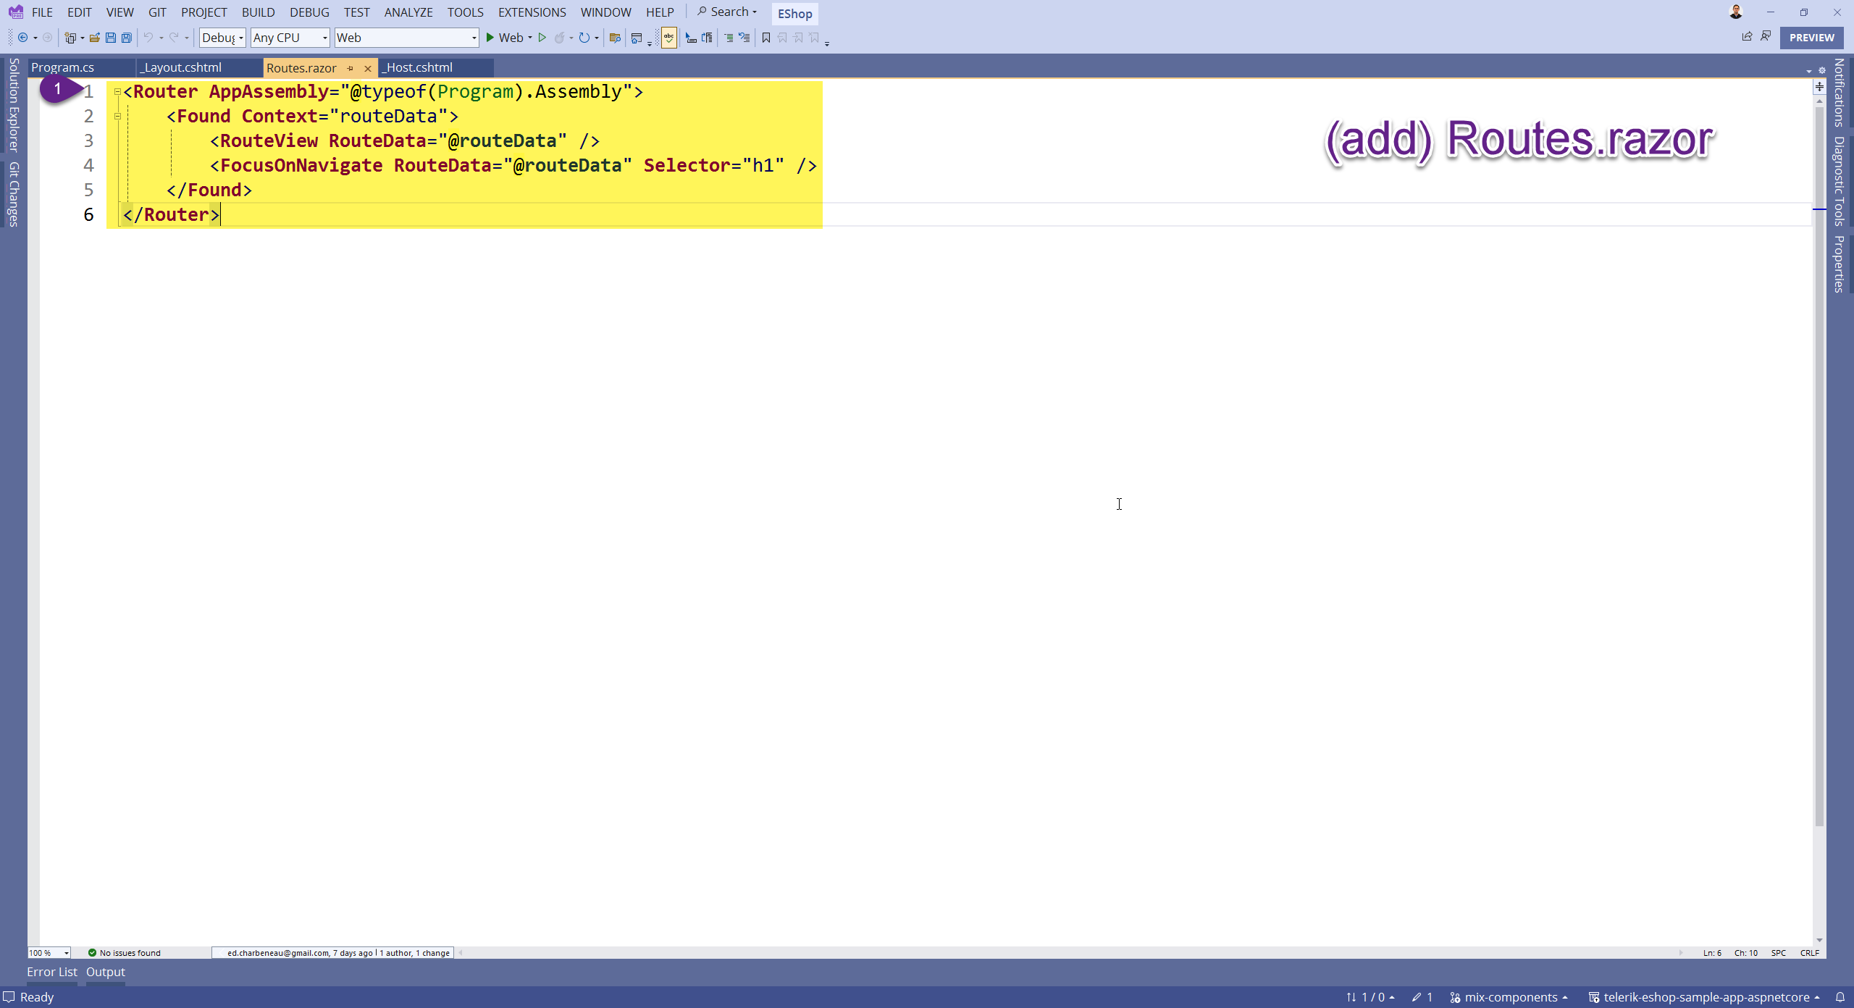

Slide 20
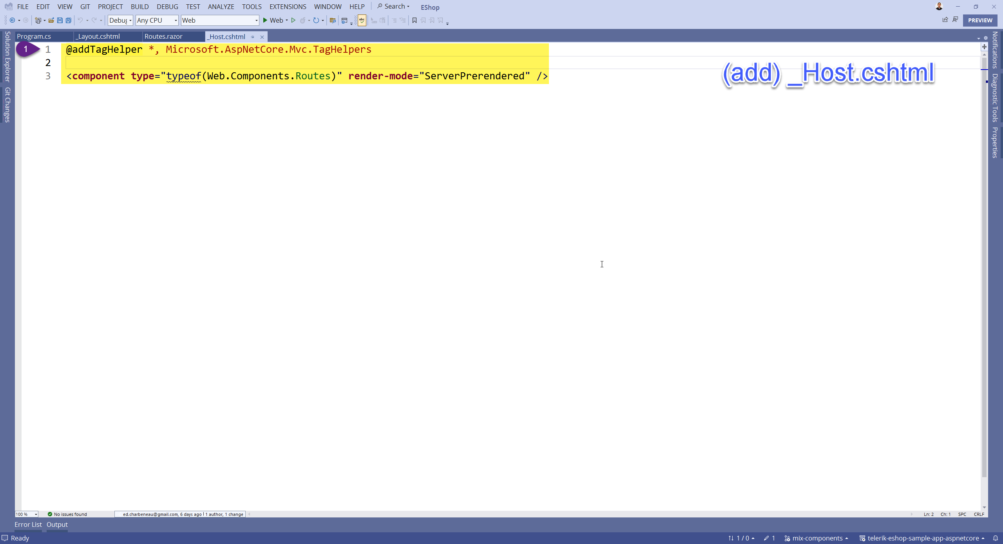

Slide 21
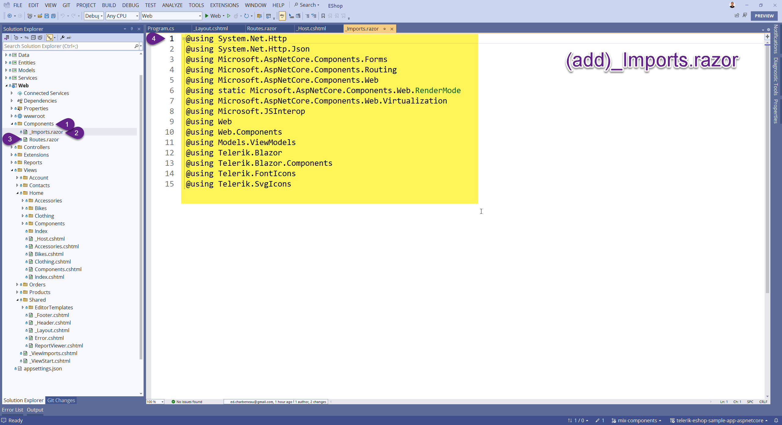

Slide 22
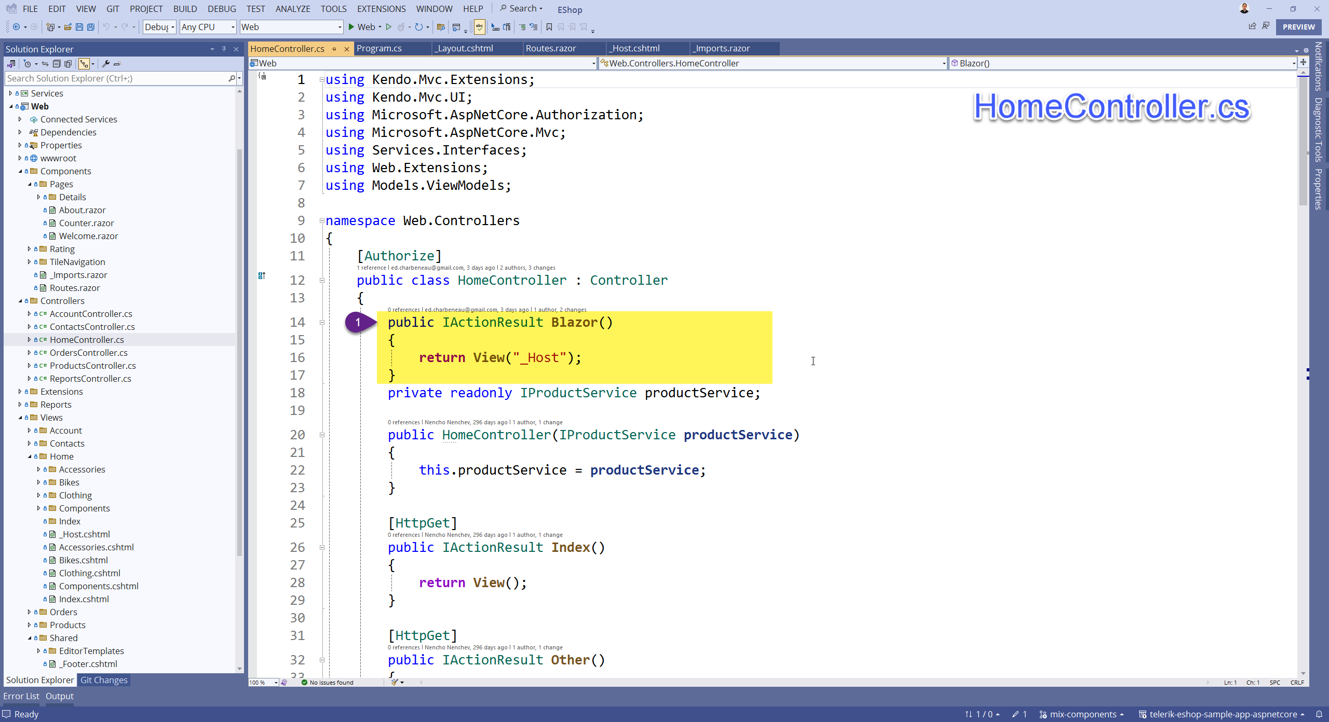

Slide 23
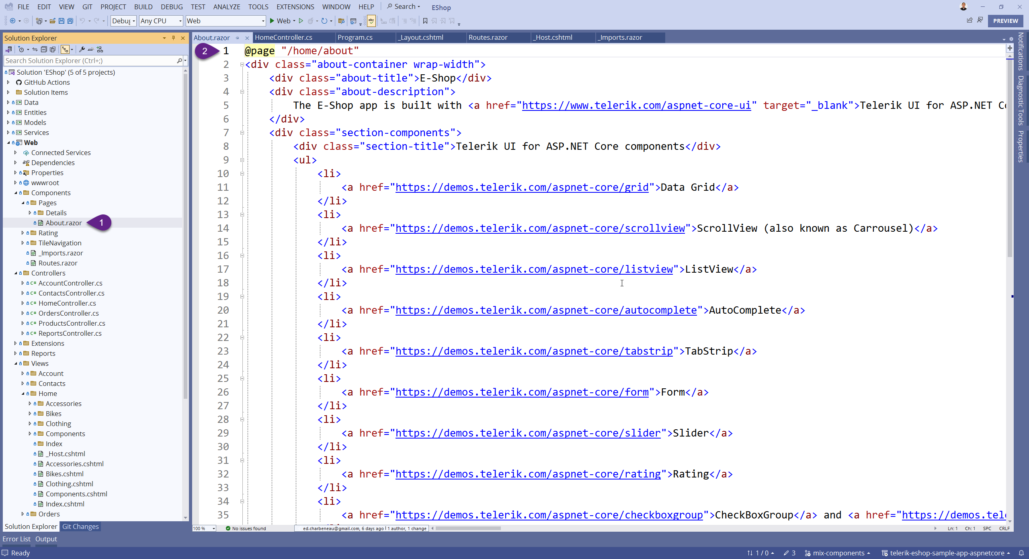
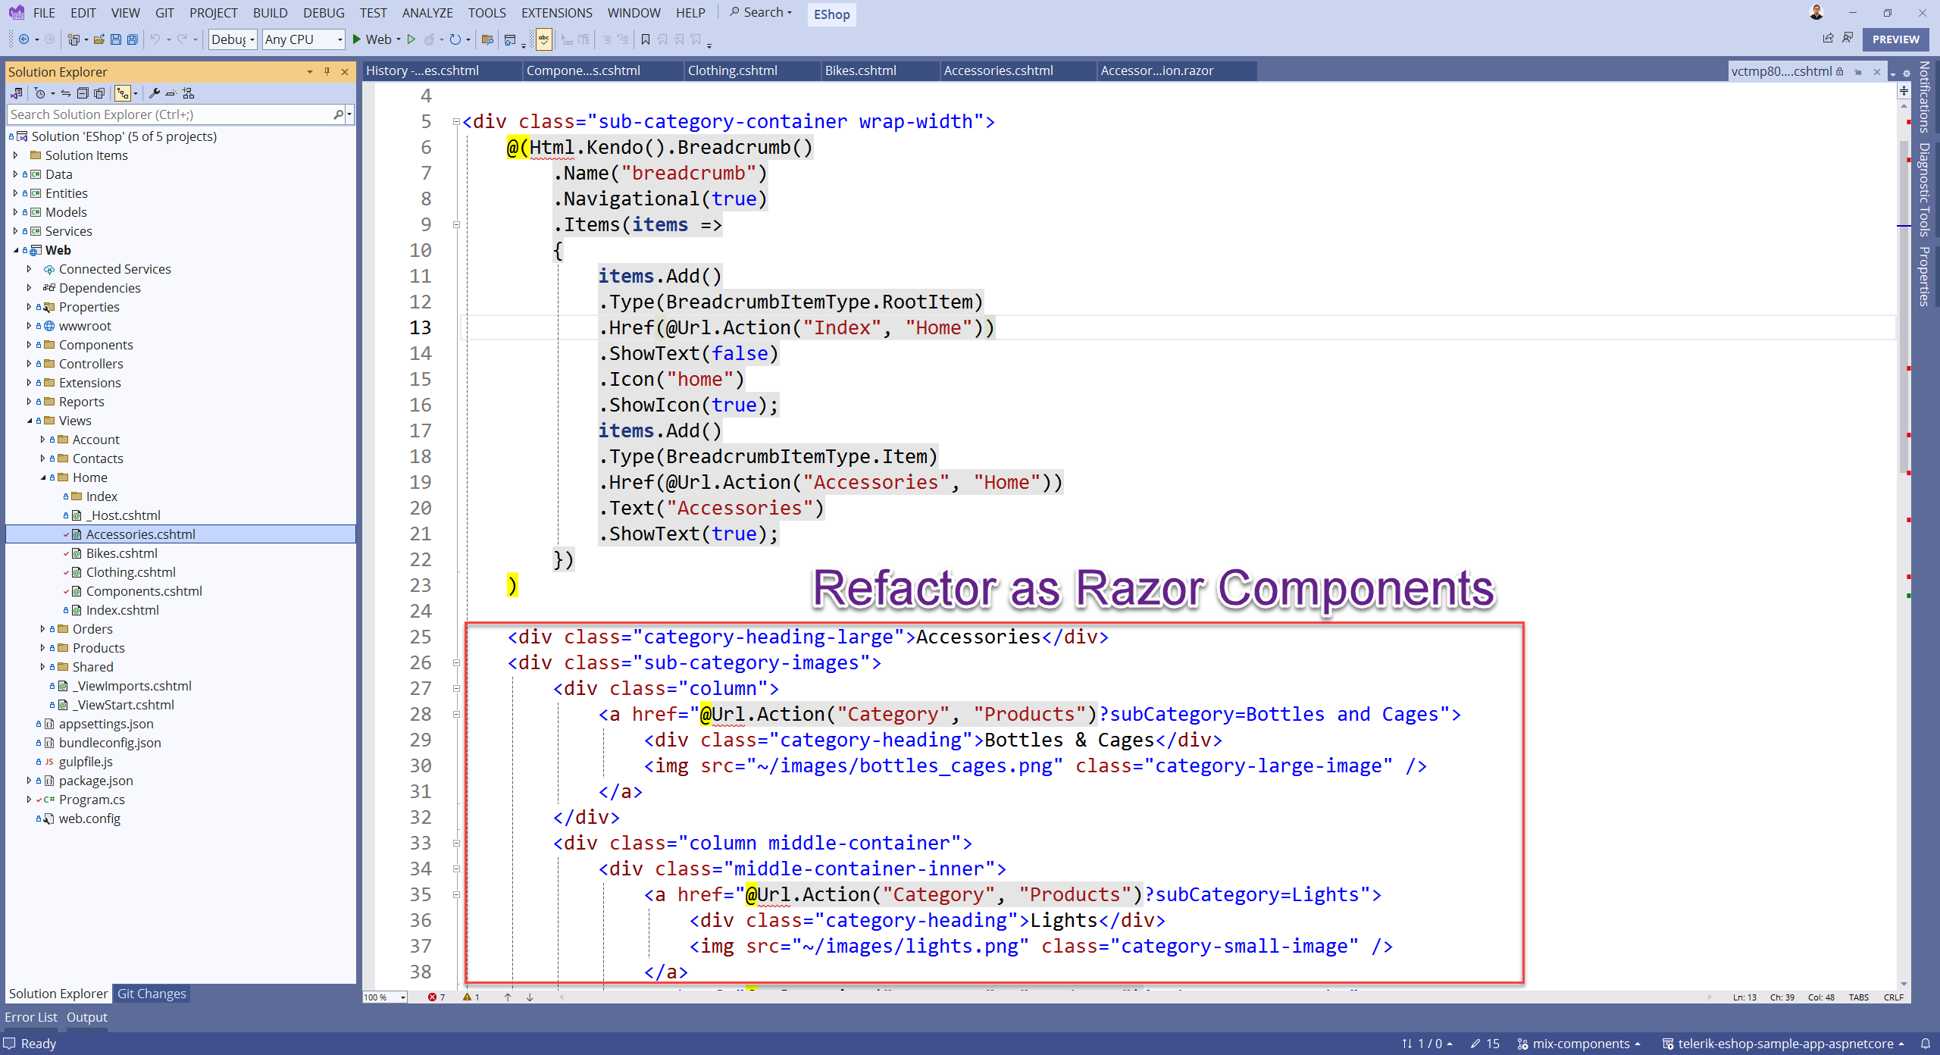

Slide 24
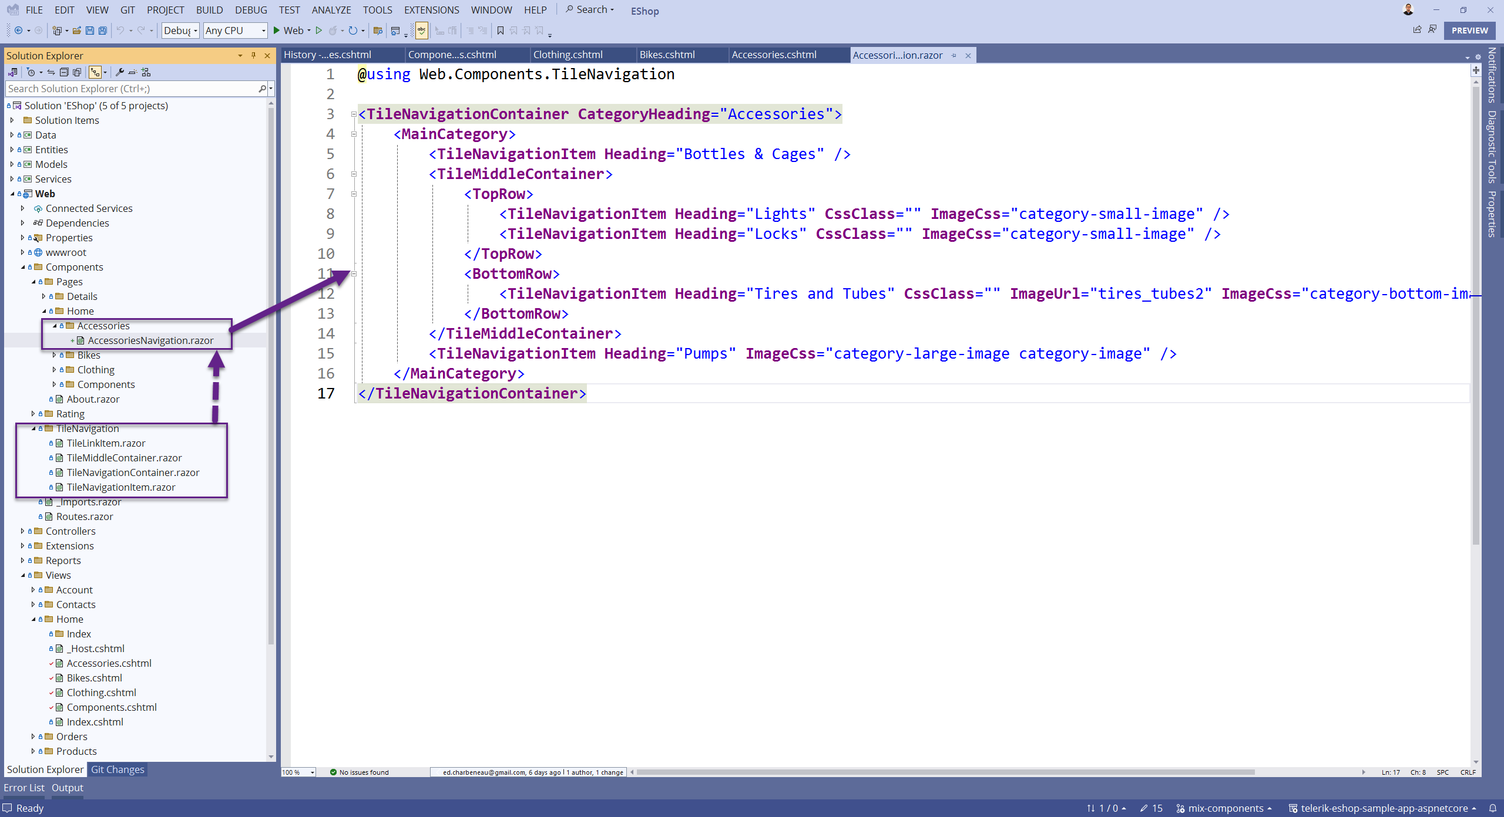

Slide 25
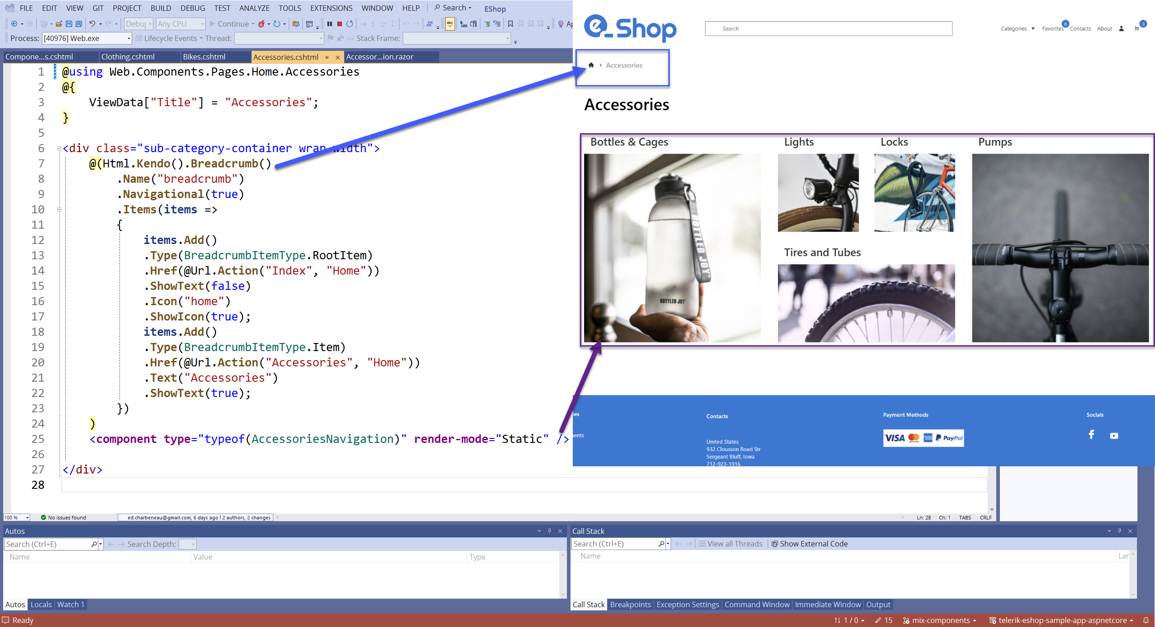

Slide 26
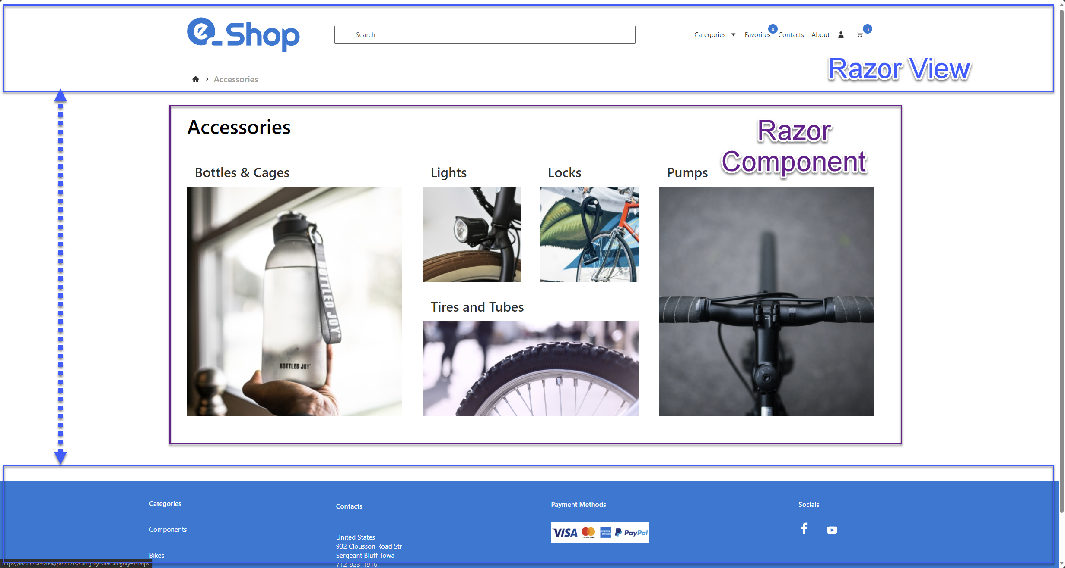

Slide 27
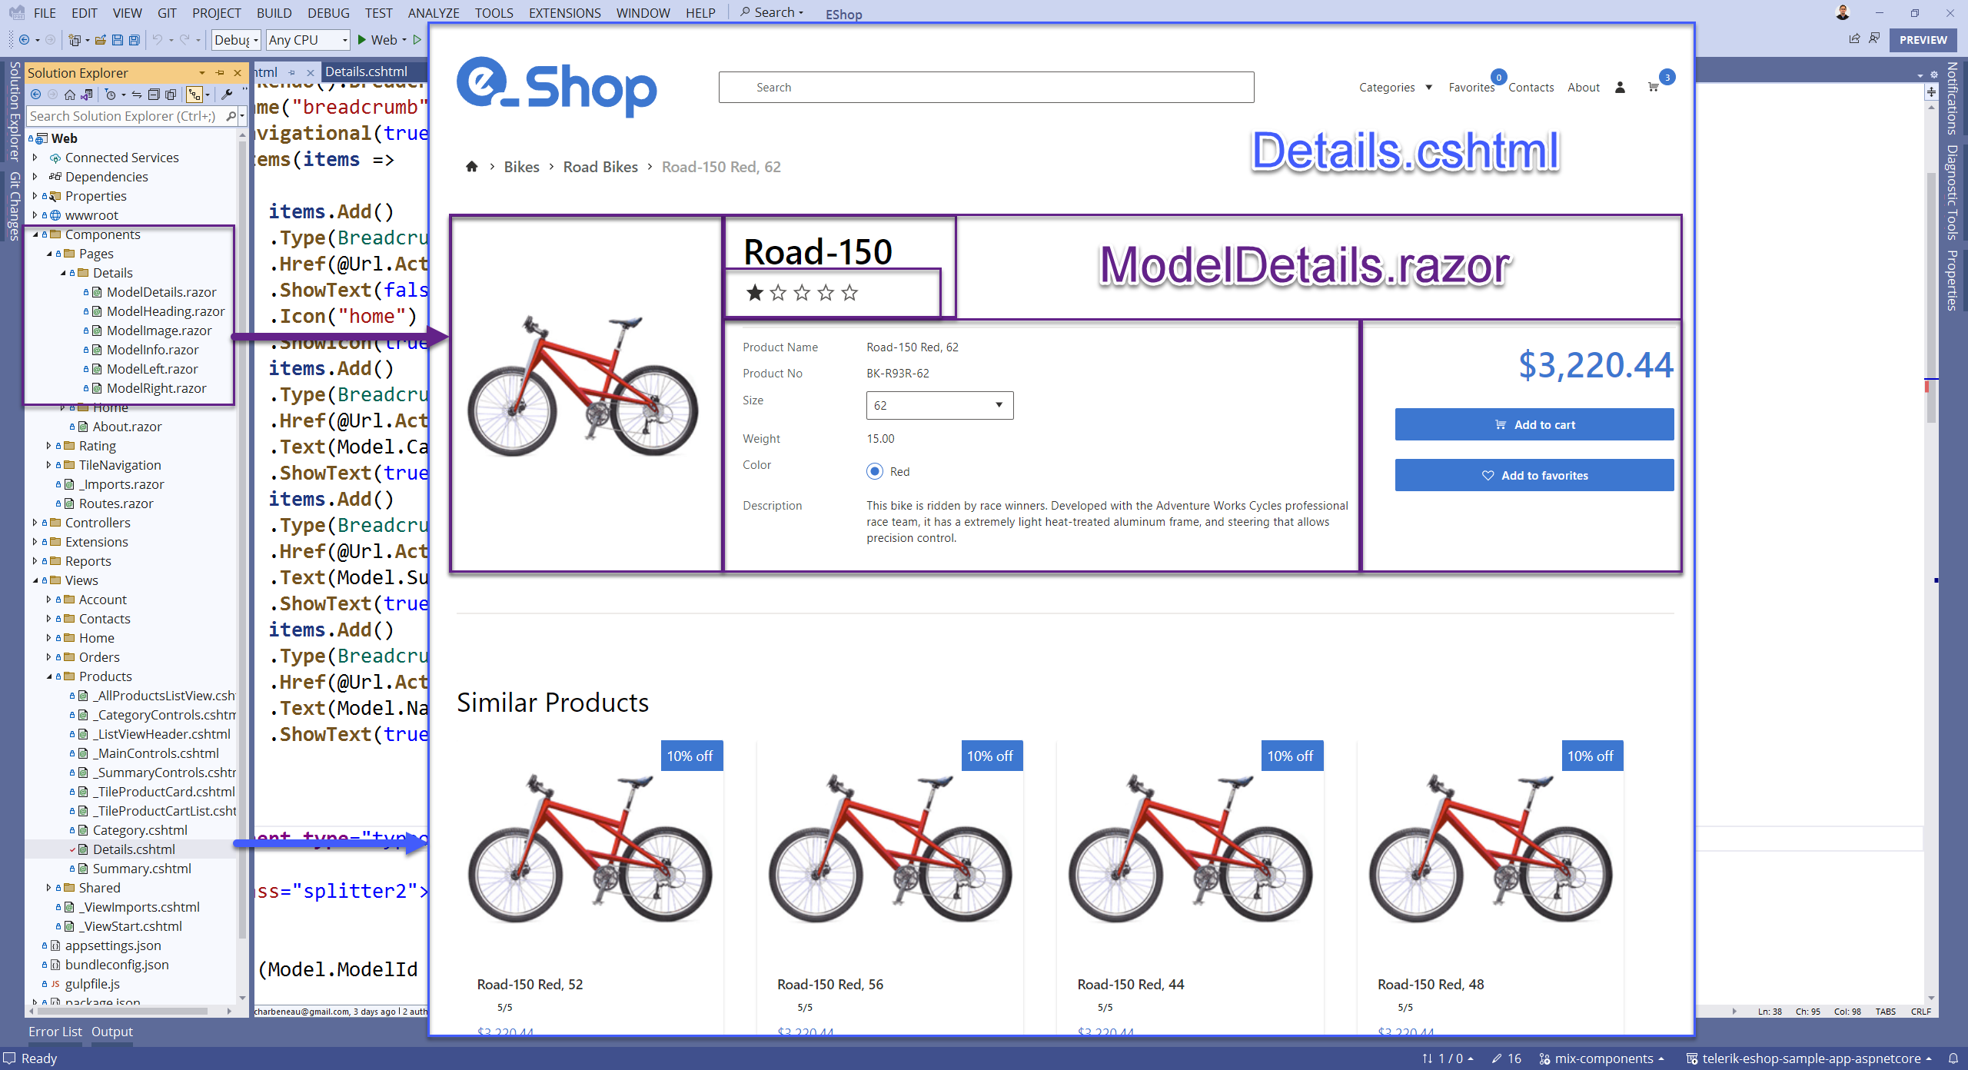

Slide 28
Blazor Custom Elements
Program.cs
App (HTML, JavaScript, WebForms)
// WebAssembly or Server
options.RootComponents
.RegisterCustomElement<Counter>
("my-counter");
<my-counter
increment-amount="10">
</my-counter>

Slide 29
Blazor in React
ASP.NET
(back end)
+
Blazor (server or wasm)
React (front end)
ReactCounter.jsx
<my-counter></my-counter>
Program.cs
RegisterCustomElement<Counter>("my-counter")

Slide 30
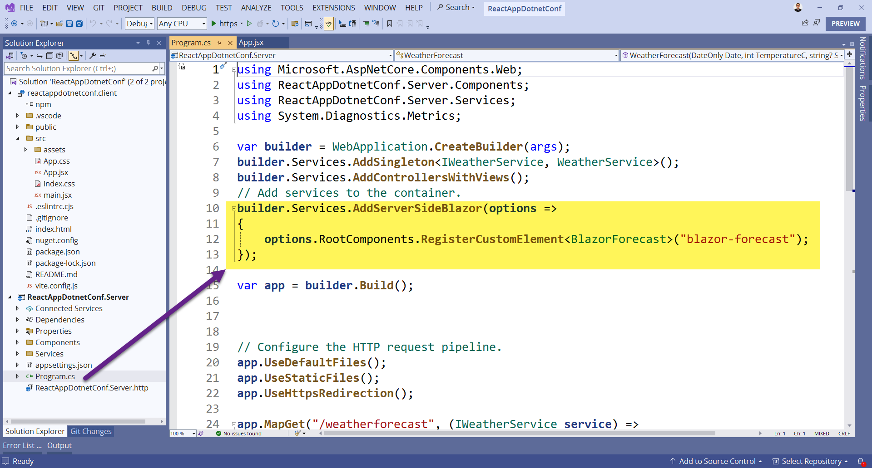

Slide 31
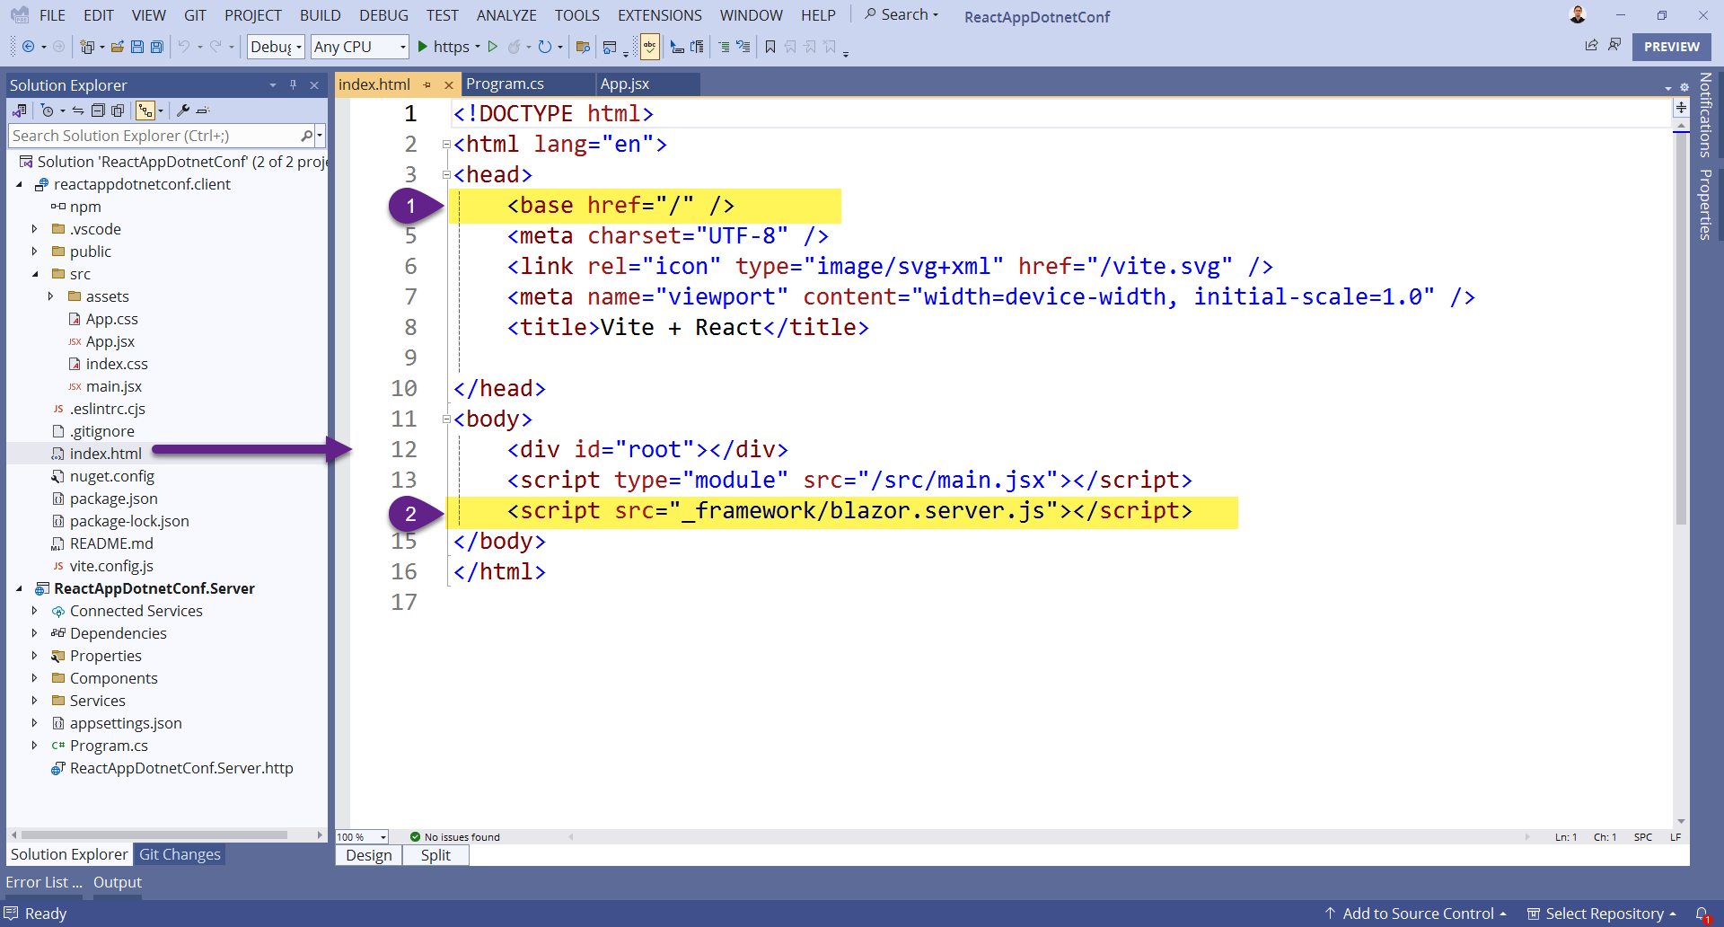

Slide 32
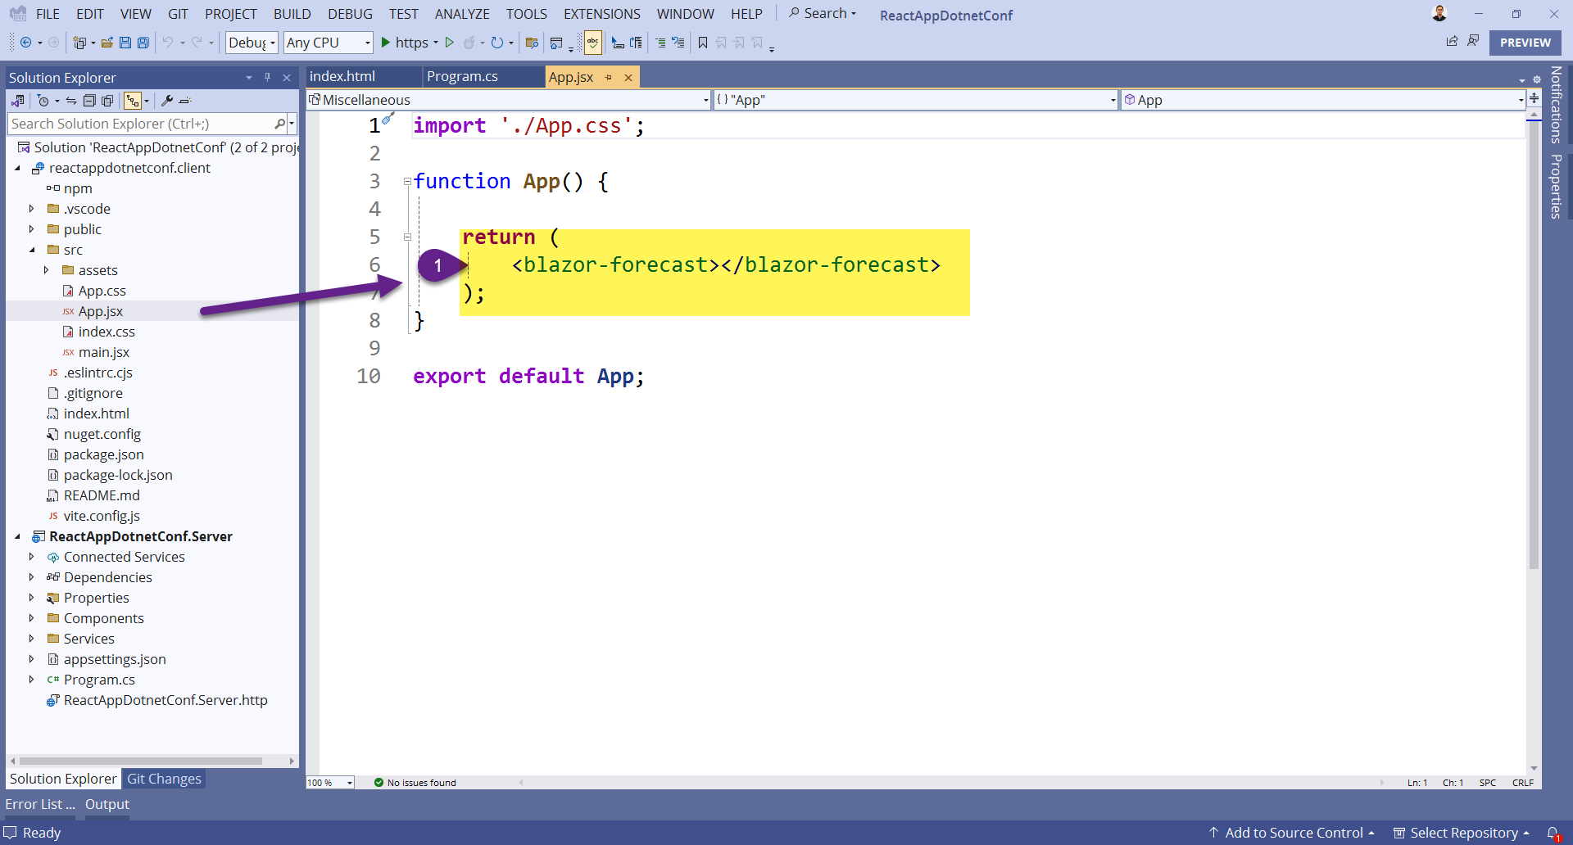

Slide 33
Blazor in Angular
ASP.NET
(back end)
+
Blazor (server or wasm)
Angular (front end)
<my-counter></my-counter>
Counter.component.html |.ts
Program.cs
RegisterCustomElement<Counter>("my-counter")

Slide 34
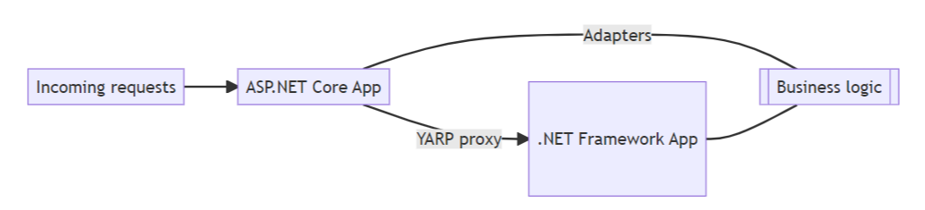
YARP + System Web Adapters
Page.aspx
Program.cs
<my-counter></my-counter>
RegisterCustomElement<Counter>("my-counter")

Slide 35
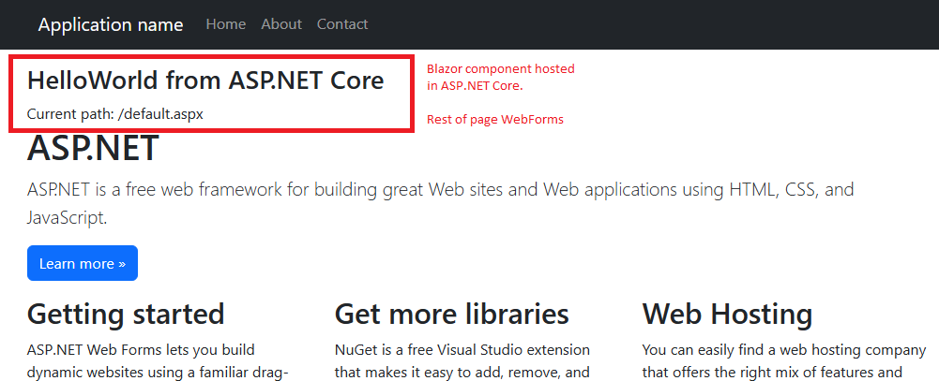
Blazor in WebForms

Slide 36



Resources
EdCharbeneau.com EdCharbeneau.com/dotnet-8
Telerik UI for Core & Blazor .NET 8 Day Zero Support! prgress.co/3QLhK2C

Slide 37
Download .NET 8
https://aka.ms/get-dotnet-8

